Slide 1
The University Connection Technology Web
UCTechWeb.com

Slide 2


LOGGED IN AS A STUDENT
TechWebs are the selected (People/clubs/companies/Comp Hosts that you selected to follow. Click this will always take you to the
UCTechWeb page but it’ll start with displaying the companies you follow first.
This photo is your profile photo. It appears after you make your User Profile page. This will always take you back to your user page. This is when you are logged in as a Student. The User slide is (PAGE )
This should lead to a forum page. Forum page not finished yet. Should we try to use stack overflow?
Search allows you to search by School, Person, Club, Company, Competition, State, City.
UCTechWeb
MY
MESSAGES
FORUM
JOB OPPORTUNITIES
Q-JOBS
MY
TECHWEBS
BRANDON
ASME
BRANDON TORRES
MAP
AIAA
3DP
Send a message to someone. Refer to Messages page
A Quick Job is when a employee or individual needs a job done at a quickly. They are able to offer up an incentive. Refer to Q-Job Page.
Clicking “UCTechWeb” will always bring you back to the main page. (PAGE 3)
Clicking Map brings you to the Map screen (PAGE 4). To click map you click upside down arrow that will make “Map” pop up
These is all the clubs that you are registered in when you make your profile.
Refer to Job Opportunities page

Slide 3
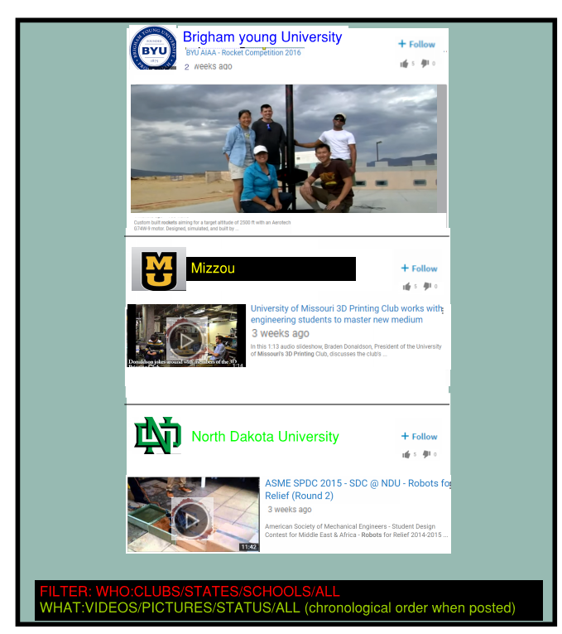
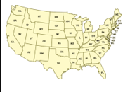
UCTechWeb
MY
MESSAGES
FORUM
JOB OPPORTUNITIES
Q-JOBS
MY
TECHWEBS
BRANDON
ASME
BRANDON TORRES
TechWeb
MAP SEARCH
TECHWEB FILTER OPTIONS. SHOWS ONLY SCHOOLS YOU WANT TO FOLLOW
Follow

Slide 4
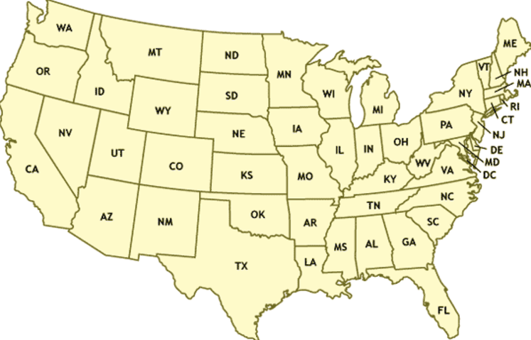
UCTechWeb
MY
MESSAGES
FORUM
JOB OPPORTUNITIES
Q-JOBS
MY
TECHWEBS
BRANDON
ASME
BRANDON TORRES
state/school/club

Slide 5
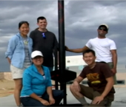

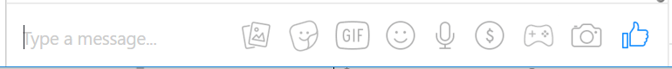


MESSAGES
AIAA: University of Missouri Columbia
AIAA: University of Missouri Columbia
Hey we are having a meeting June 5th
ASME: Nellie Messler
Okay!
Hey we are having a
That’s pretty cool
Use Emoji
Attachment
Send Email Address

Slide 7
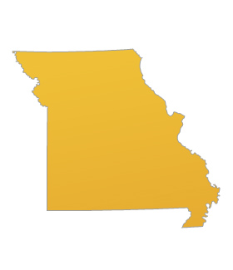

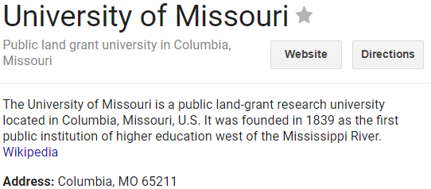

UCTechWeb
MY
MESSAGES
FORUM
JOB OPPORTUNITIES
Q-JOBS
MY
TECHWEBS
BRANDON
ASME
BRANDON TORRES
State/school/club

Slide 8
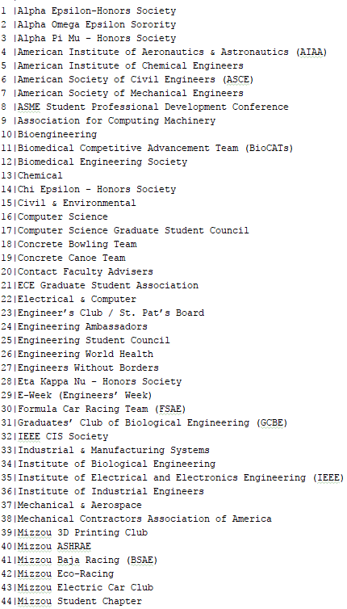
UCTechWeb
MY
MESSAGES
FORUM
JOB OPPORTUNITIES
Q-JOBS
MY
TECHWEBS
BRANDON
ASME
BRANDON TORRES
CLUBS (LINKS)

Slide 9

UCTechWeb
MY
MESSAGES
FORUM
JOB OPPORTUNITIES
Q-JOBS
MY
TECHWEBS
BRANDON
ASME
BRANDON TORRES
Quick Jobs
COMPANY/PERSON | TITLE | Location | DATE START | DATE DUE | REWARD | FILE
Boeing | Design Engineer | Saint Louis MO | 05/22/2017 | 07/05/2017 | $2000
Mike Jones | App Designer | Bridgeton MO | 05/13/2017 | 05/22/2017 | $600

Slide 10
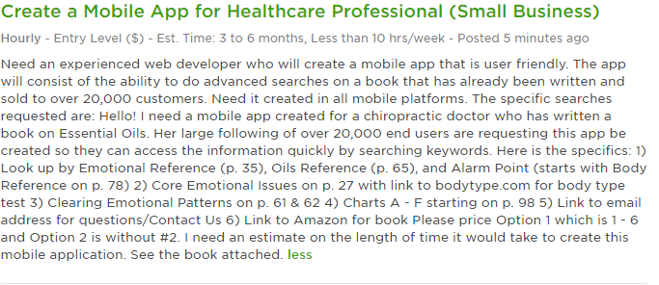
UCTechWeb
MY
MESSAGES
FORUM
JOB OPPORTUNITIES
Q-JOBS
MY
TECHWEBS
BRANDON
ASME
BRANDON TORRES
Quick Job Attachment
SOME PEOPLE WON’T WANT TO POST THEIR IDEA DIRECTLY WITHOUT SIGNED DOCUMENTATION. IF THAT’S THE CASE
IT CAN BE GENERIC. AND ONLY SAY CONTACT IF INTERESTED. Would like to charge a small fee (10$ or so to post something like this
Or we can think of a better way to make it legit so no scams happen.
CONTACT: TORRESFTW06@GMAIL.COM
NAME: BRANDON
JOB: WILL GO OVER AFTER CONVERSATION AND SIGNED DOCUMENTION STATING THAT THE IDEA CANNOT BE STOLEN

Slide 11
UCTechWeb
MY
MESSAGES
FORUM
JOB OPPORTUNITIES
Q-JOBS
MY
TECHWEBS
BRANDON
ASME
BRANDON TORRES
Job Opportunities
COMPANY | TITLE | Location | DATE | FILE
Boeing | Design Engineer | Saint Louis MO | 05/22/2017
Universe Corp | Modeler | Bridgeton MO | 05/13/2017

Slide 12
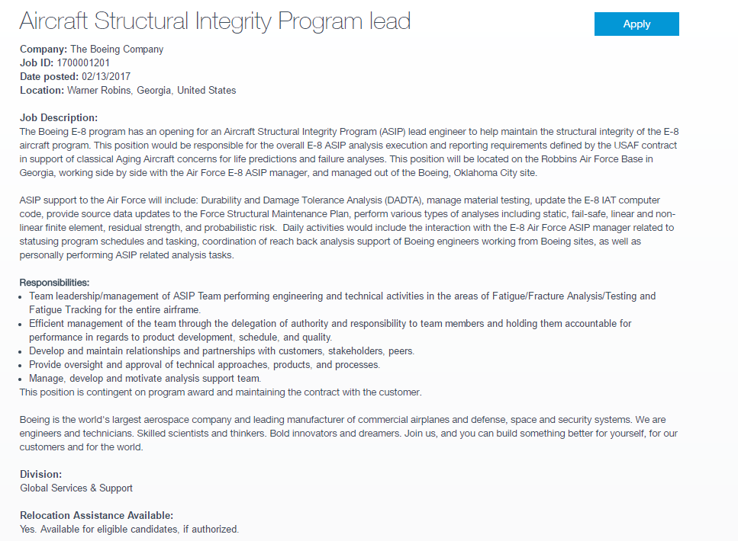
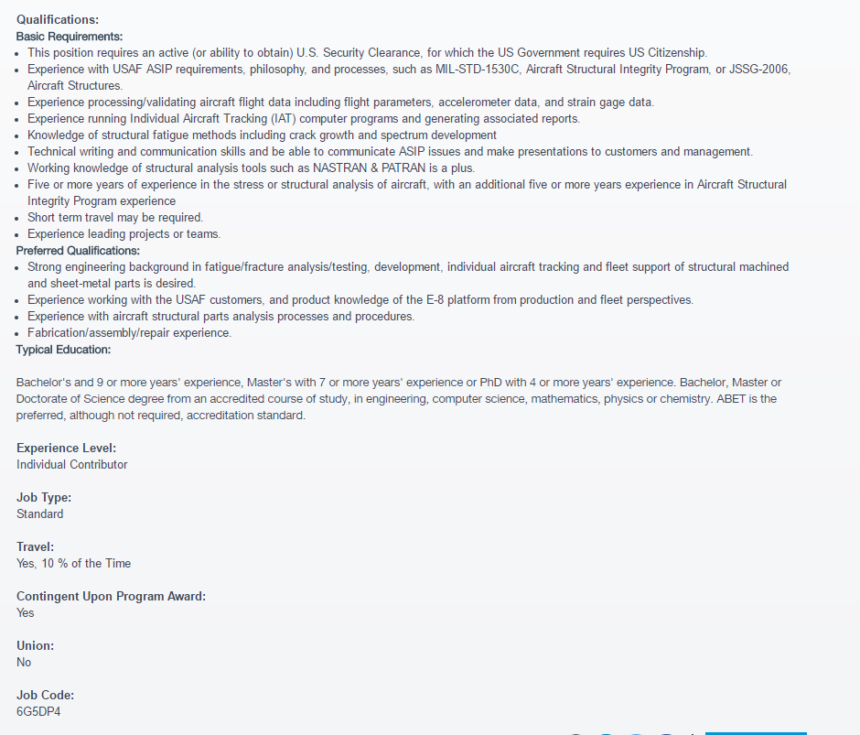
UCTechWeb
MY
MESSAGES
FORUM
JOB OPPORTUNITIES
Q-JOBS
MY
TECHWEBS
BRANDON
ASME
BRANDON TORRES
ATTACHED JOB OPPORTUNITY FILE

Slide 13
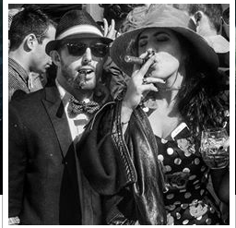
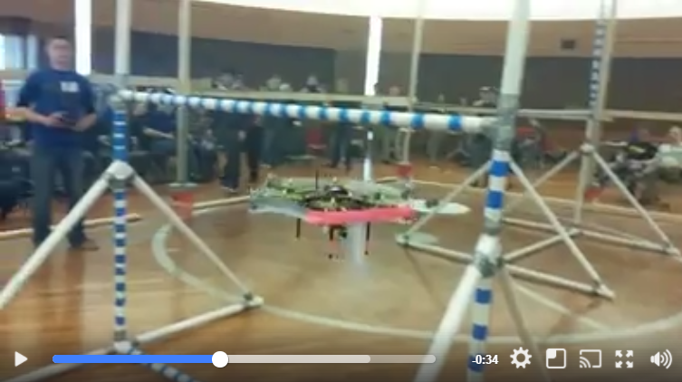
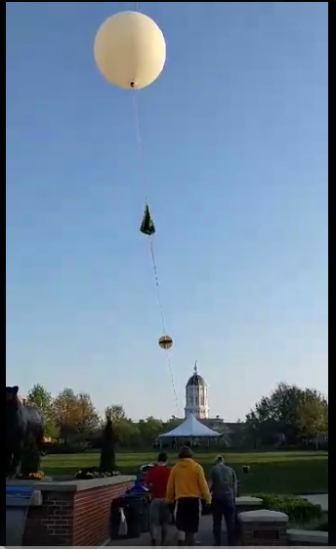
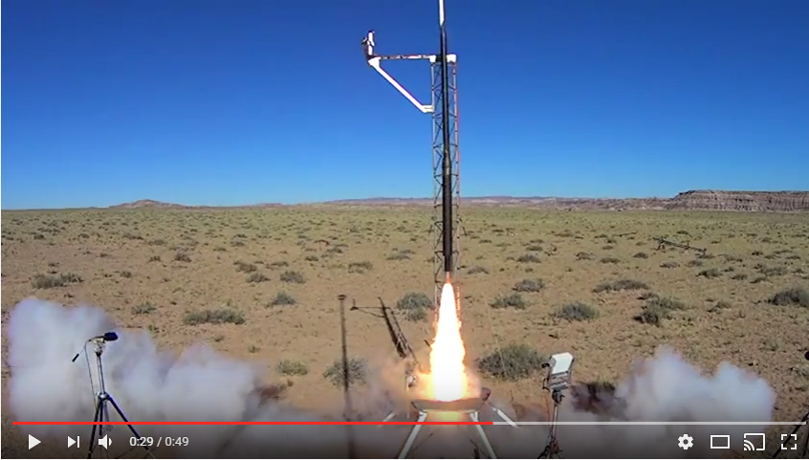
UCTechWeb
MY
MESSAGES
FORUM
JOB OPPORTUNITIES
Q-JOBS
MY
TECHWEBS
BRANDON
ASME
BRANDON TORRES
Expected graduation date: BRANDON TORRES MECHANICAL ENGINEERING
May 2017
Photos
Videos
MESSAGE
Email
Clubs: (CLICK FOR THE CLUB MIZZOU SITE)
American Society of Mechanical Engineers – Vice President
Students for the Exploration and Development of Space- Vice President
American Institute of Aeronautics and Astronautics-Treasurer
3D printing Club-Secretary
[ASME] American Society of Mechanical Engineers –
I held the position of team lead when we placed 2nd in the Lighter than Air ASME Robotics competition of 2014. Modeled and 3d printed the frame. Solely designed the landing structure. Soldered electronics and assisted in the coding of the software.
[Displays only 5 sentences, clicks to open]
See more
[SEDS]- Students for the Exploration and Development of Space-
Co-created Mizzou chapter of SEDS. Designed rocket to fly to the stratosphere and capture video footage of the curvature of the earth.
See more
[AIAA] American Institute of Aeronautics and Astronautics-
As treasure I managed all funding that came through AIAA. I was also the design leader of the Rocket Team. Designed recovery system of our rocket that went mach 1.4 and 9425ft in the air. Placed 4th in the ESRA Intercollegiate Rocket Engineering Competition.
See more
About me: (10 sentences)
Balsdjfalsdfafj
Asdjf;alsdjfasl;jdfa
Al;sdjfa;lsjdfal;jsdfa
A;lsjdf;lajsdfal;js
As;fjasl;jfal;jsd
Asldjfal;sjdfals;jfa
Al;jsdfa;ljsdfa;ljas
Df;a
[Click for Resume] – (Companies get full access. Students don’t. Students must ask permission with permission notification)

Slide 14

USER PROFLE EDIT PAGE
Expected graduation date: Name: Major:
Contact Info
Message:
Email:
Phone Number:
Add Profile photo
Add Videos
Add Photos
Clubs: (Pick by searching @(club_school)
Club Name from above:_________________
Describe your involvement of the club. Talk about your best moment or something interesting to catch attention to the readers. This will only display the first 5 sentences until the reader clicks expand. Add photos/videos to the right showing this moment. The first picture/video will be on display
ADD PHOTOS AND VIDEOS
Add Club
About me: (10 sentences)
Write a short summary about yourself. Anything you want someone to read that would increase your opportunity for jobs and other opportunities.
Resume’: (Add File)
You can restrict this resume to companies, competitition hosts, and/or students.

Slide 15

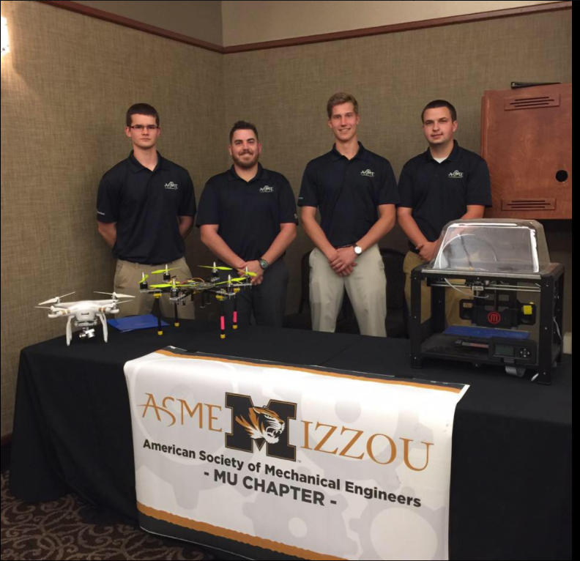
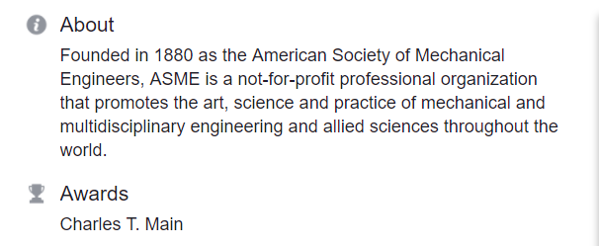
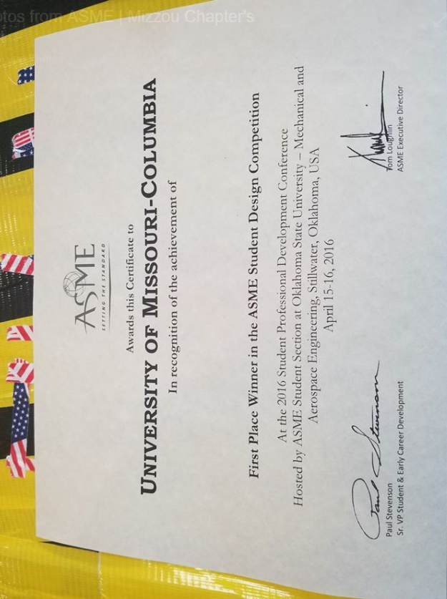
BRANDON
TORRES ASME
BRANDON
TORRES
ASME: American Society of Mechanical Engineers
UNIVERSITY OF MISSOURI COLUMBIA
MEETINGS:
BUILD TEAM MEETINGS: MWF 6:00pm
NEXT MONTHLY MEETING:June 2 2017 time = 6:00pm
Members:
President: Bob Johnson
Vice President- Sarah Sue
CSC Involved: Joe Muenk
more...
COMPETITIONS:
ASME ROBOTICS 2017
ASME ROBOTICS 2016
ESRA 3D MECHANICS 2015
MAJOR:
90% MECHANICAL
5% ELECTRICAL
3% COMPUTER SCIENCE
2% BUSINESS
[ASME] American Society of Mechanical Engineers –
DATE: 01-25-2017
We have a robotics team that travels around the world and competes against all different universities. The team is lead by Brandon Torres, a senior mechanical Engineer as well as advisor Dr. Solbreken. Together we learn to overcome real world challenges in a smaller scale through competition. If you are into robotics, challenges, and competition please follow us on CSC and come to our meetings!!!

Slide 16
CLUB
University
Member names:
Pres:
Vp:
Sec:
Trea:
TechWeb Most Points:
Contact Info
Message:
Email:
Phone Number:
Add Profile photo
Add Videos
Add Photos
About: (10 sentences)
Write a short summary about the club. What you guys do and why you do it. This will help recruit students and companies as well as other prospects.
Awards:
Competitions:
Major:
Other:
Name of the competition/thing:
Write about the competition and post pictures and videos on the right hand side. The 5 lines will be displayed before the reader has to click “read”.
ADD PHOTOS AND VIDEOS
Add Competition

Slide 17
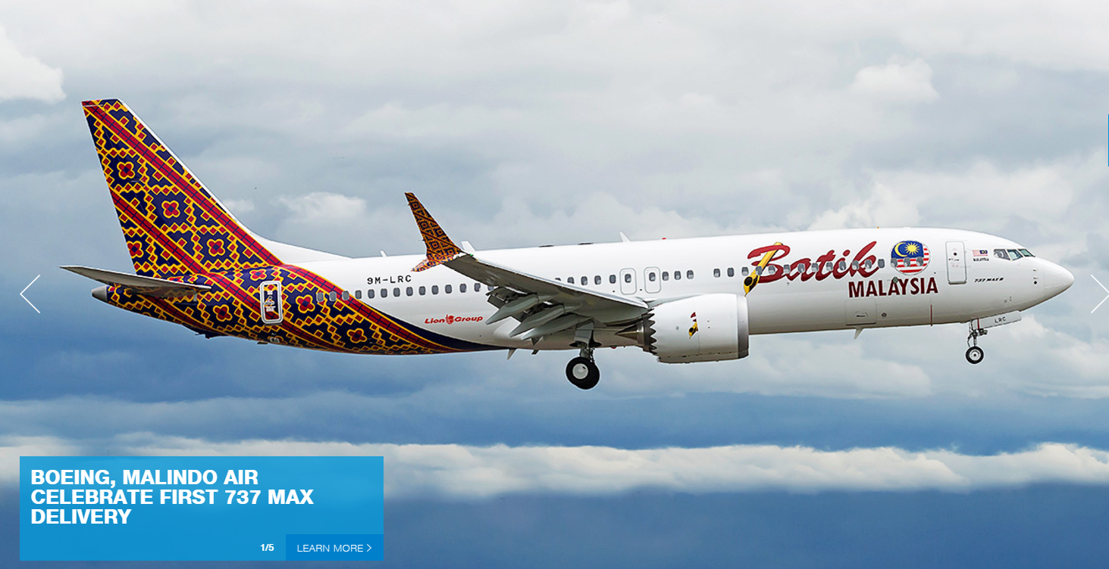

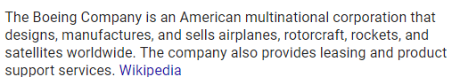
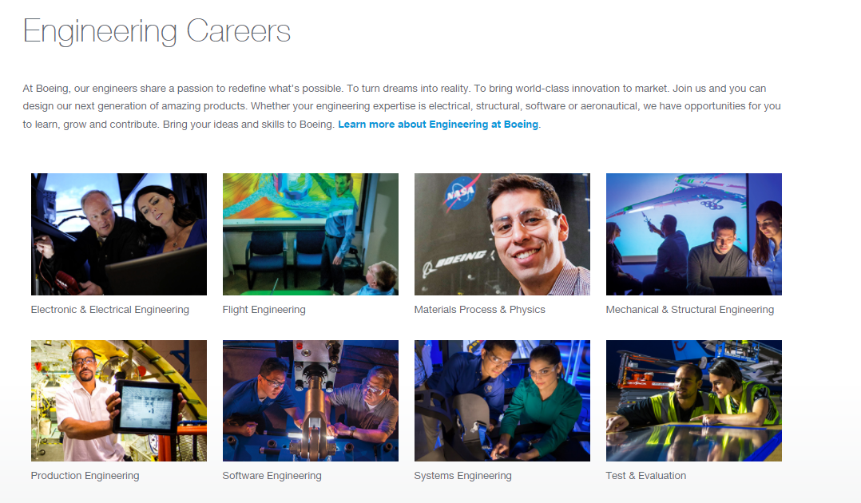
BRANDON
TORRES ASME
BRANDON
TORRES
Validated
BOEING
Apply
ABOUT:
What we look for:

Slide 18
COMPANY NAME
University
Member names:
Pres:
Vp:
Sec:
Trea:
TechWeb Most Points:
Contact Info
Email:
Phone Number:
Add Profile photo
Add Videos
Add Photos
Job openings
About: (10 sentences)
Write a short summary about the company. What you do and the type of students you look for.
New Hot Topics. Job positions
Write about the competition and post pictures and videos on the right hand side. The 5 lines will be displayed before the reader has to click “read”.
ADD PHOTOS AND VIDEOS
Add Competition

Slide 19

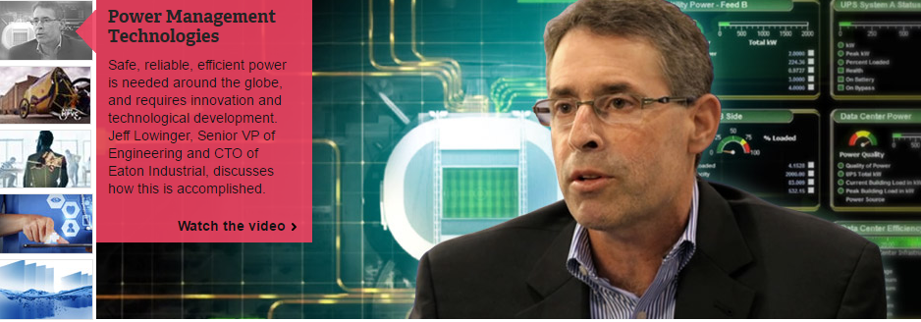




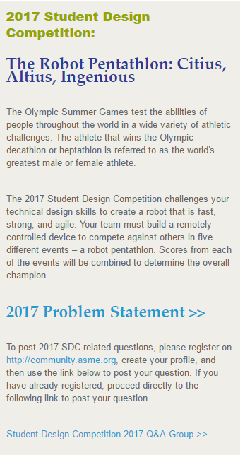
BRANDON
TORRES ASME
BRANDON
TORRES
Validated
ASME: American Society of Mechanical Engineers
Wanna be a ASME National member?
ABOUT:
COMPETITIONS:
IDSC THE CHALLENGE:
DATE: MAY 1 2018
WHO: ASME MEMBERS
WHERE: TBD
THE ROBOT PENTATHLON
DATE: JUNE 11 2018
WHO: ASME MEMBERS
WHERE: TBD

Slide 20
First Page
First Name:
Last Name:
Password:
School Email:
Student/Company/Competition Host
Join Now
------------------------------------------------------
If Student is selected. These are added
College:
Major:
College:___________ (IF NOT EXIST) Ask Name, address
Clubs:
Anticipated Graduation Date: Month/Year
-------------------------------------------------------
If Company is selected. These are added
Company Name:
Company Address:
---------------------------------------------------------
If Competition host is selected, these are added
Majors that compete:

Slide 21
TECH WEB SCORE BOARD
Name | School | Questions Answered | Questions Asked | Points
Brandon Torres | University of Missouri Columbia | 15 | 4 | 2500
Stefano Menci | Harvard | 6 | 11 | 2350
Monica Vollmer | University of Mississippi | 4 | 5 | 1800
Bob Dylan | University of New York | 2 | 3 | 1100
BECAUSE WE ARE NOT SURE IF WE ARE USING STACK OVERFLOW OR A MADE FORUM . DO YOU THINK IT WOULD BE WISE TO WAIT ON THIS SCOREBOARD/FORUM THING UNTIL WE HAVE A LOT OF USERS. AND THEN WE CAN BRING IT OUT?

